Slide 1
The Marketing Mix

Slide 2
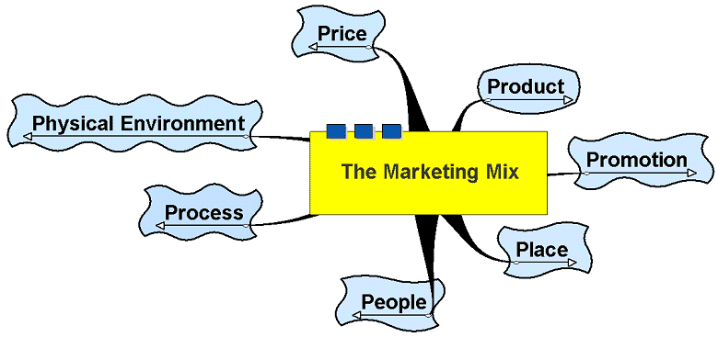
The Marketing Mix

Slide 3
The Marketing Mix
The tools available to a business to gain the reaction it is seeking from its target market in relation to its marketing objectives
7Ps – Price, Product, Promotion, Place, People, Process, Physical Environment
Traditional 4Ps extended to encompass growth of service industry

Slide 4
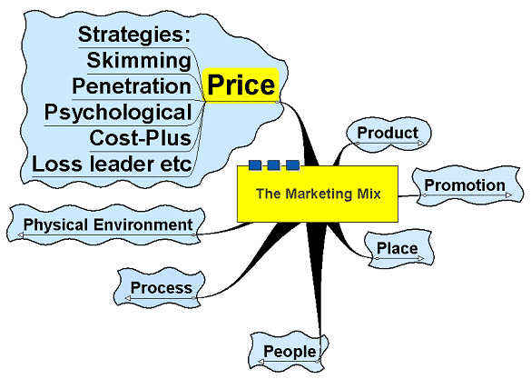
Price

Slide 5
Price
Pricing Strategy
Importance of:
knowing the market
elasticity
keeping an eye on rivals
Image copyright: www.freeimages.co.uk

Slide 6
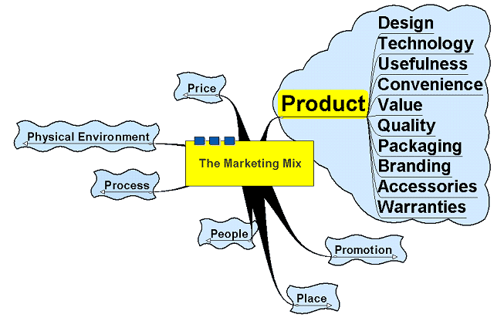
Product

Slide 7
Product
Methods used to improve/differentiate the product and increase sales or target sales more effectively to gain a competitive advantage e.g.
Extension strategies
Specialised versions
New editions
Improvements – real or otherwise!
Changed packaging
Technology, etc.
Image copyright: www.freeimages.co.uk

Slide 8
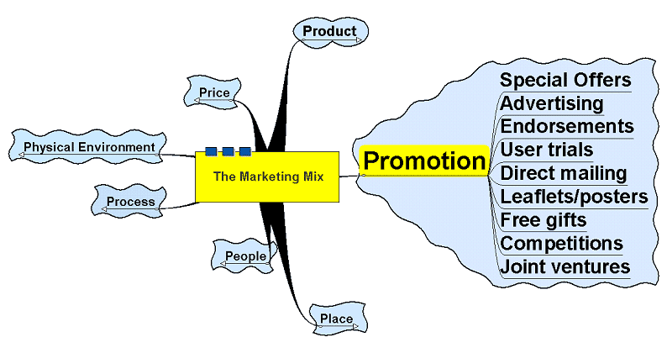
Promotion

Slide 9
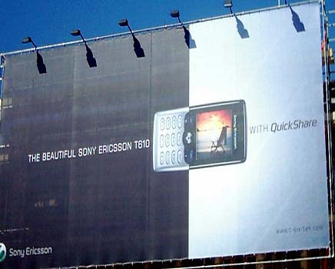
Promotion
Strategies to make the consumer aware of the existence of a product or service
NOT just advertising

Slide 10
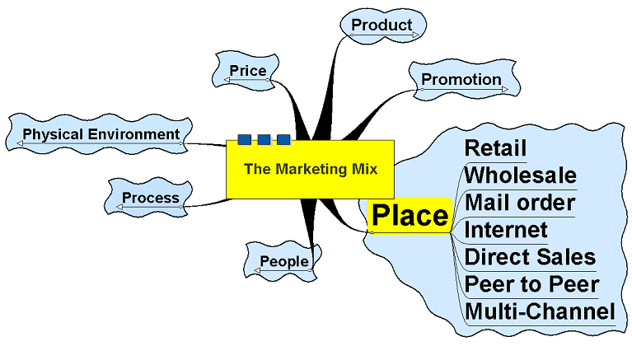
Place

Slide 11
Place
The means by which products and services get from producer to consumer and where they can be accessed by the consumer
The more places to buy the product and the easier it is made to buy it, the better for the business (and the consumer?)

Slide 12
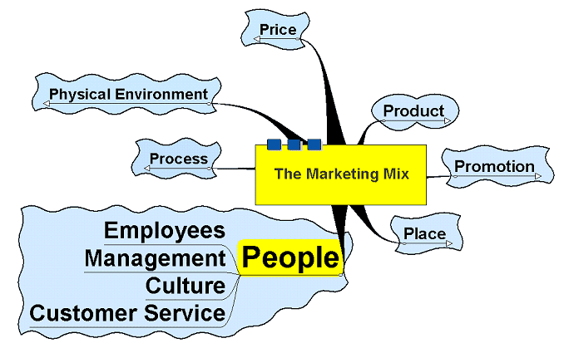
People

Slide 13
People
People represent the business
The image they present can be important
First contact often human – what is the lasting image they provide to the customer?
Extent of training and knowledge of the product/service concerned
Mission statement – how relevant?
Do staff represent the desired culture of the business?

Slide 14
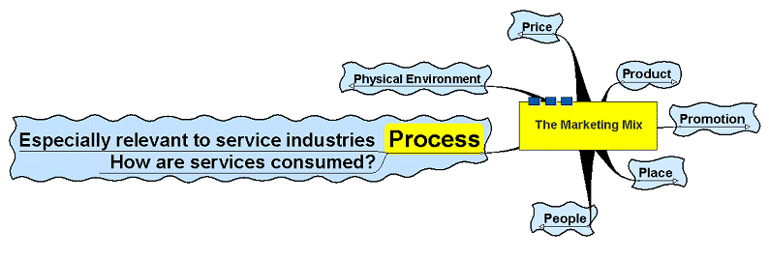
Process

Slide 15
Process
How do people consume services?
What processes do they have to go through to acquire the services?
Where do they find the availability of the service?
Contact
Reminders
Registration
Subscription
Form filling
Degree of technology

Slide 16
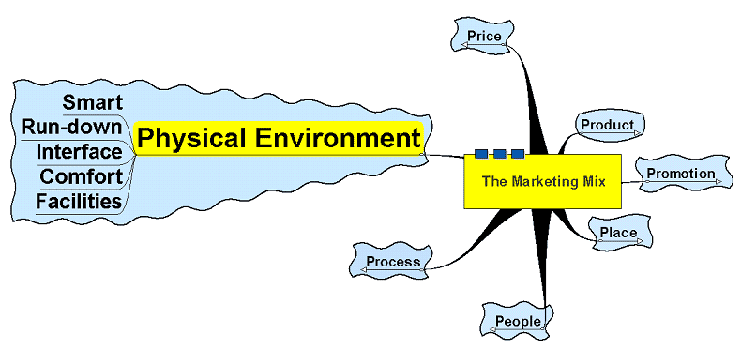
Physical Environment

Slide 17
Physical Environment
The ambience, mood or physical presentation of the environment
Smart/shabby?
Trendy/retro/modern/old fashioned?
Light/dark/bright/subdued?
Romantic/chic/loud?
Clean/dirty/unkempt/neat?
Music?
Smell?

Slide 18
The Marketing Mix
Blend of the mix depends upon:
Marketing objectives
Type of product
Target market
Market structure
Rivals’ behaviour
Global issues – culture/religion, etc.
Marketing position
Product portfolio
Product lifecycle
Boston Matrix

